Slide 1
Beginner Level for Android Development using Kotlin
Instructor: Ferry Yuwono

Slide 2
Module 1:
Introduction to Android and Kotlin

Slide 3


1.1 Introduction + Course Outline
Introduction to Android and Kotlin
Kotlin is a modern statically typed programming language used by over 60% of professional Android developers that helps boost productivity, developer satisfaction, and code safety.
Since the release of Android Studio 3.0 in October 2017, Kotlin has been included as an alternative to the standard Java compiler
On 7 May 2019, Google announced that the Kotlin programming language is now its preferred language for Android app developers
Notes:
Reference:
https://en.wikipedia.org/wiki/Kotlin_(programming_language)
https://developer.android.com/kotlin

Slide 4
1.1 Introduction + Course Outline
Course Outline
Module 1: Introduction to Android and Kotlin
1.5 Kotlin Language
1.6 Declare Variables and Data Types
1.7 Array and Collections
1.8 Conditions
1.9 Loops
1.10 Functions
1.11 Class and Data Class
1.1 Introduction + Course Outline
1.2 Install Android Studio
1.3 Create First Android Application
1.4 Setup Android Emulator

Slide 5
1.1 Introduction + Course Outline
Course Outline
Module 2: Develop Your First Android Application
2.1 Android Project Structure
2.2 Layouts and TextView
2.3 EditText and Button
2.4 ImageView and ImageButton
2.5 View Binding
2.6 Persistent data
2.7 Activity and Manifest
2.8 RecyclerView and Adapter
2.9 Final Assignment

Slide 6
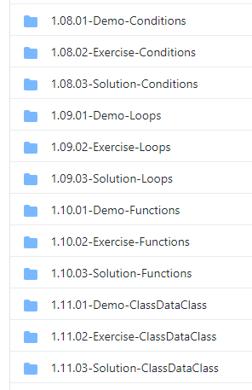
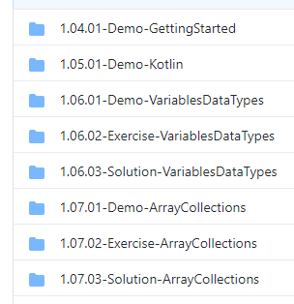
1.1 Introduction + Course Outline
Repository
https://github.com/ferryyuwono/android-beginner
Demo Code
Exercise Code
Solution Code

Slide 7
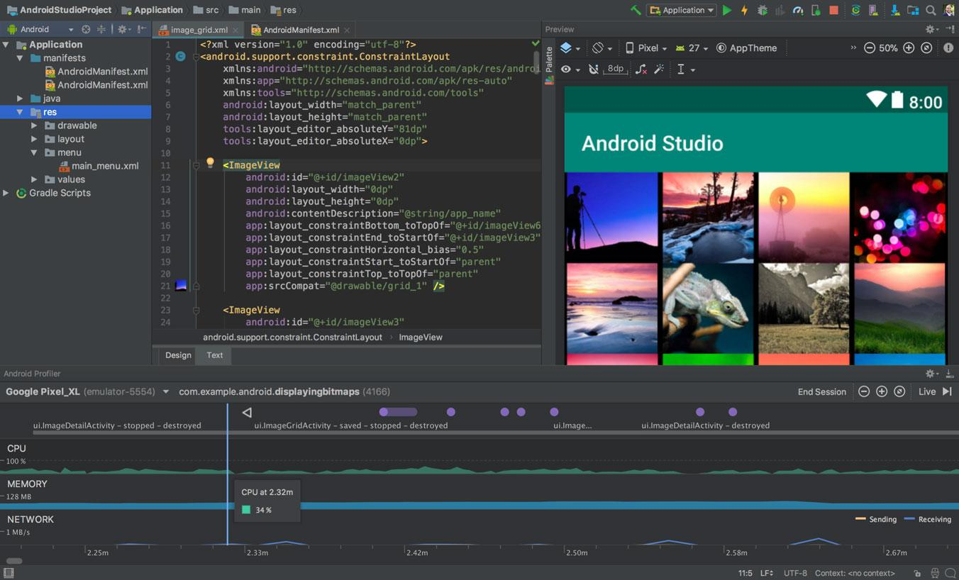
1.2 Install Android Studio
Download Android Studio
https://developer.android.com/studio
Notes:
Reference: https://developer.android.com/studio

Slide 8
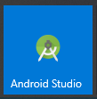
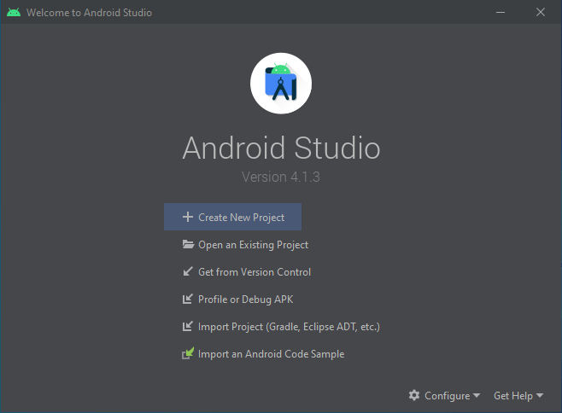
1.3 Create First Android Application
Choose Create New Project

Slide 9
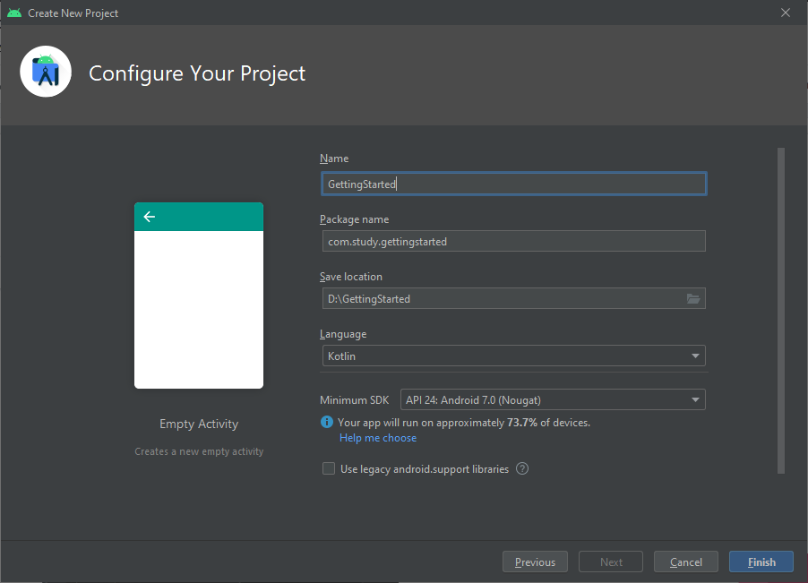
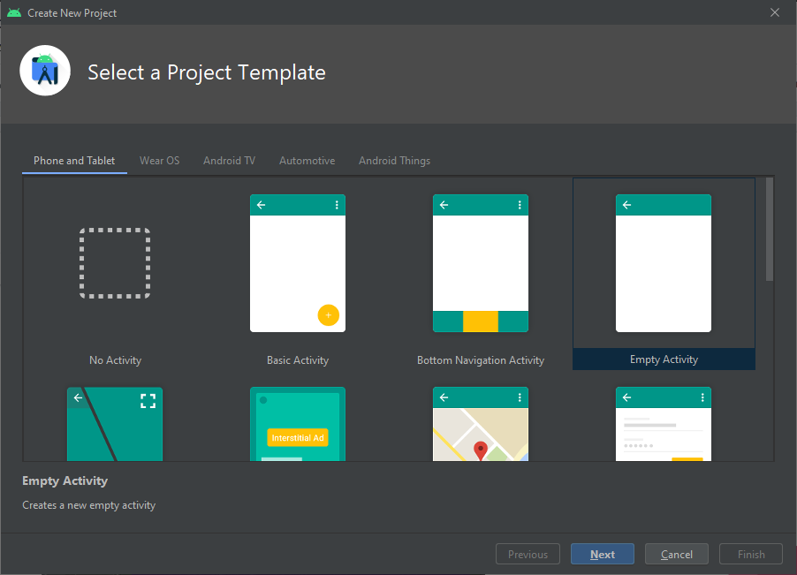
1.3 Create First Android Application
Choose Empty Activity, then Next
Fill Name, Package Name, then Finish

Slide 10
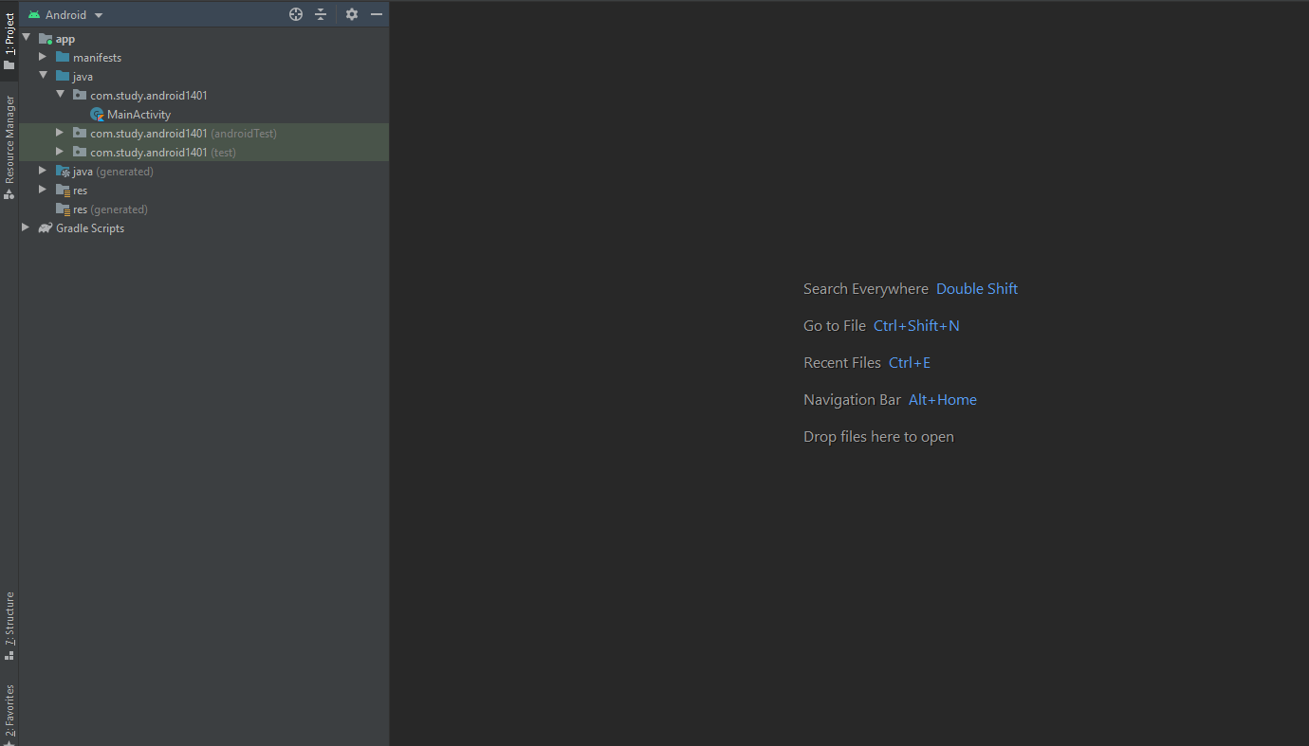
1.4 Setup Android Emulator
https://github.com/ferryyuwono/android-beginner/tree/main/1.04.01-Demo-GettingStarted

Slide 11
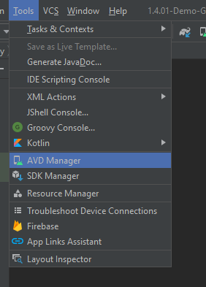
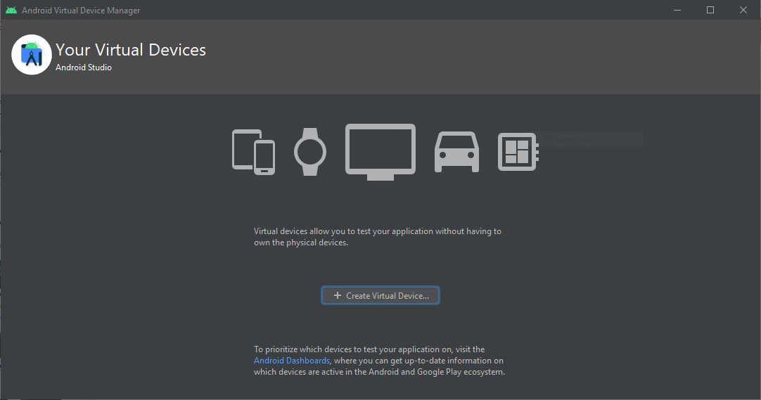
1.4 Setup Android Emulator
Tools > AVD Manager > Create Virtual Devices...

Slide 12
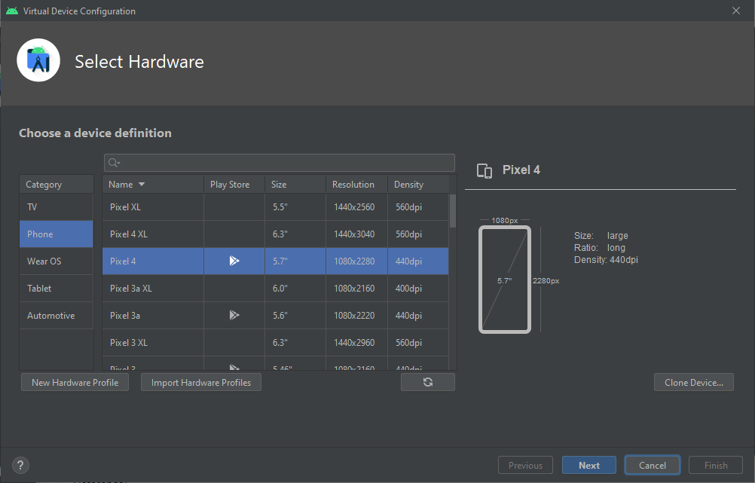
1.4 Setup Android Emulator
Make to choose device with Play Store

Slide 13
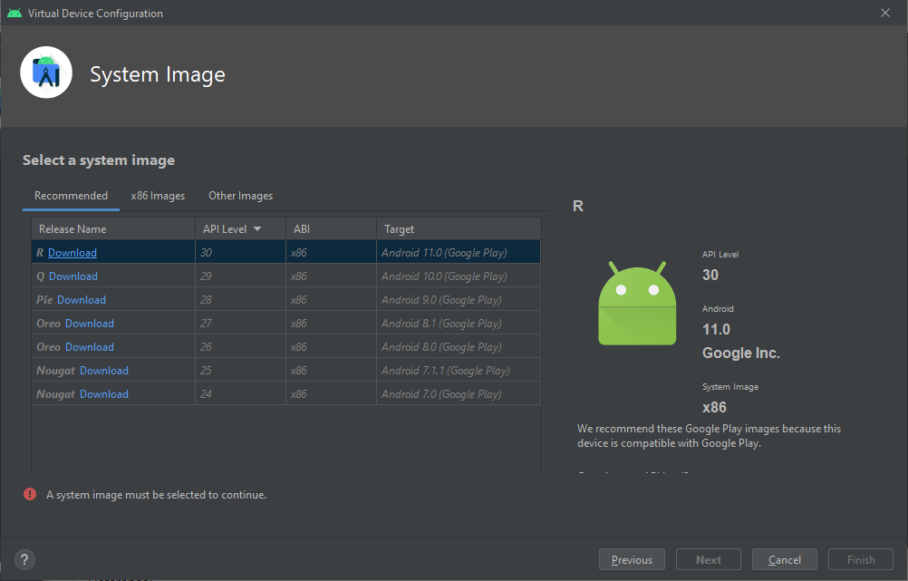
1.4 Setup Android Emulator
Target Android (Google Play)

Slide 14
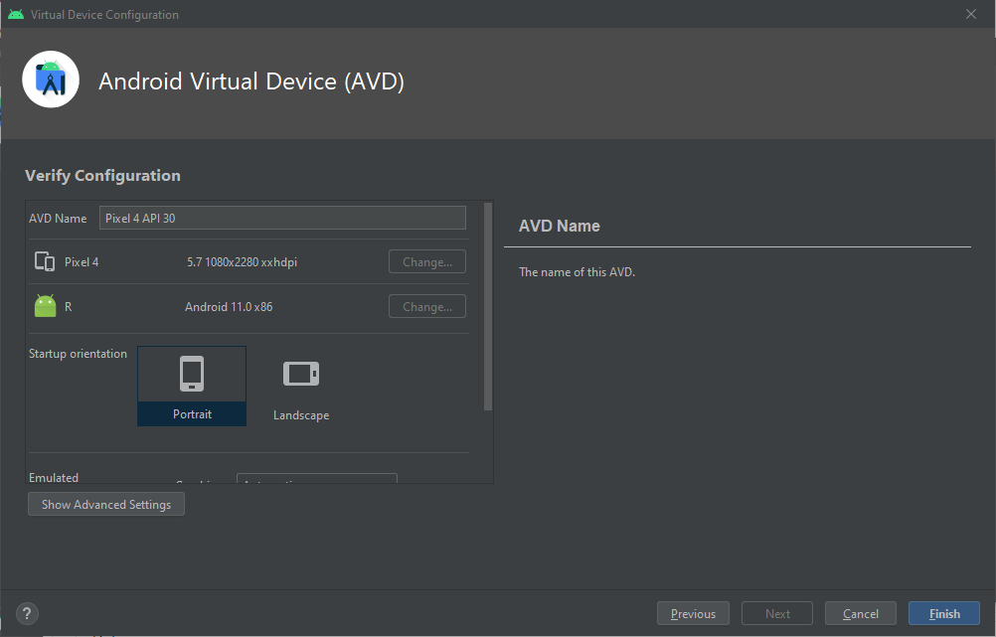
1.4 Setup Android Emulator
Finish

Slide 15
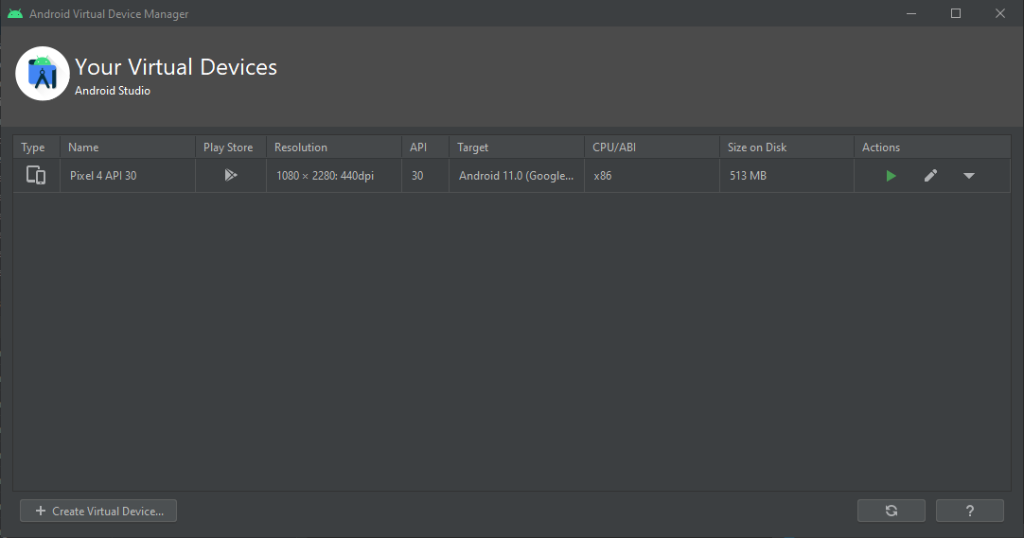
1.4 Setup Android Emulator

Slide 16
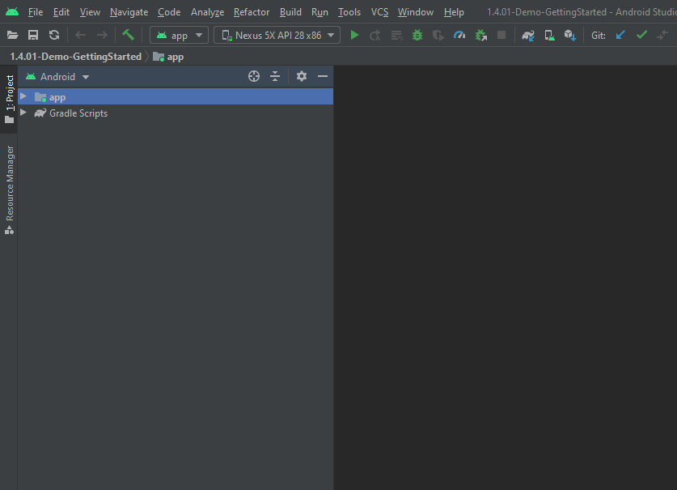
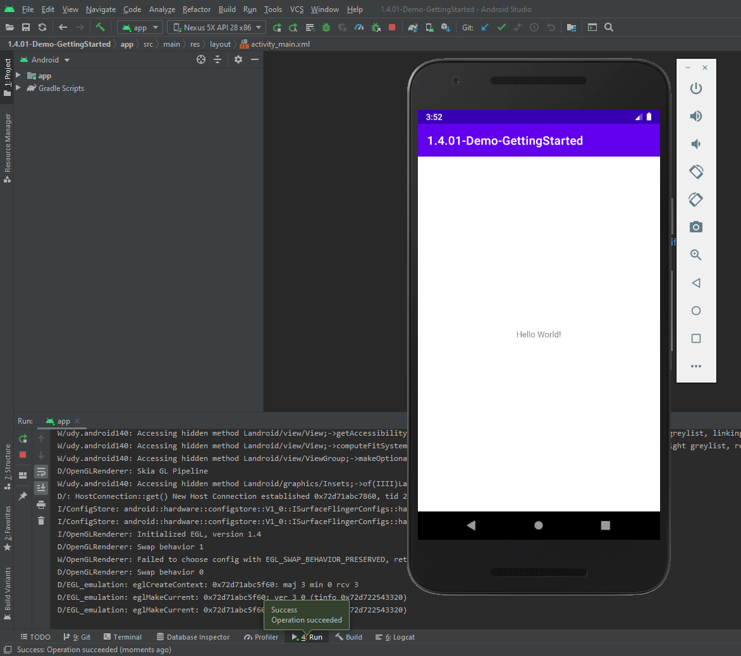

1.4 Setup Android Emulator

Slide 17
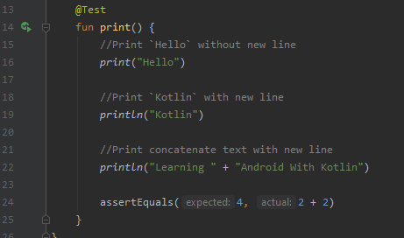
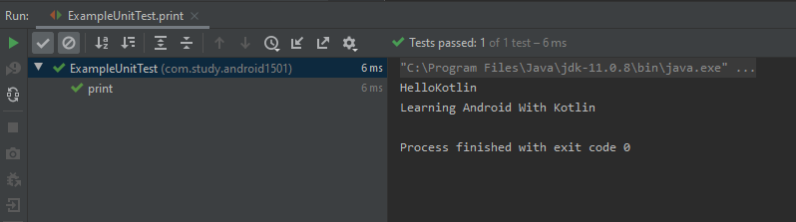
1.5 Kotlin Language
https://github.com/ferryyuwono/android-beginner/tree/main/1.05.01-Demo-Kotlin
File: ExampleUnitTest.kt
Format:
print(text to print)
println(text to print)
Add comment to code
Print standard output
Run your code

Slide 18
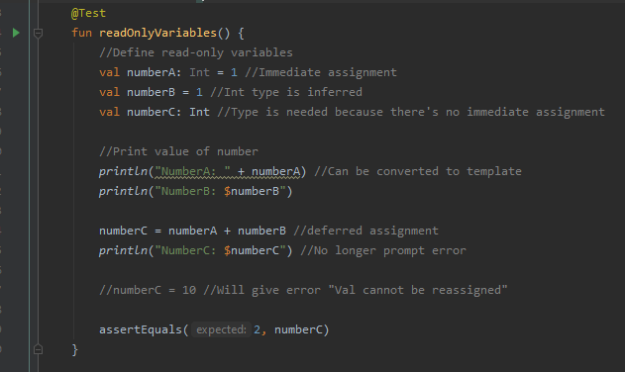
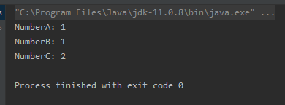
1.6.1 [Demo] Declare Variables and Data Types
https://github.com/ferryyuwono/android-beginner/tree/main/1.06.01-Demo-VariablesDataTypes
File: ExampleUnitTest.kt
Read only variables
Format:
val variable name : data type
variable name: lower camelCase (start with lowercase letter and separate the words with a single capitalized letter)
Notes:
Reference
https://en.wikipedia.org/wiki/Camel_case

Slide 19
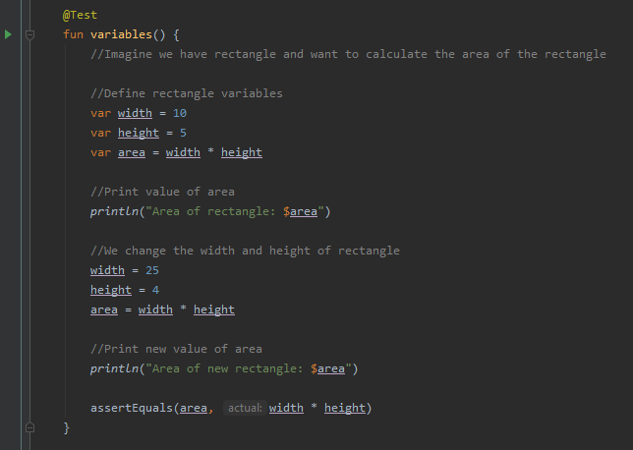
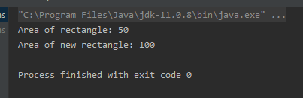
Variables
Format:
var variable name : data type

Slide 20
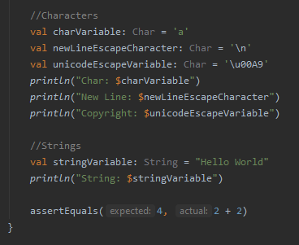
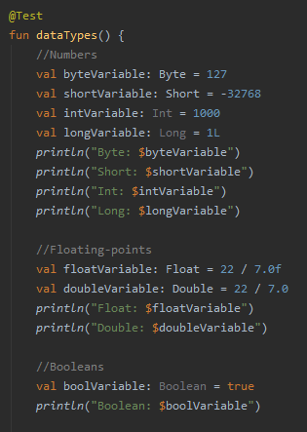
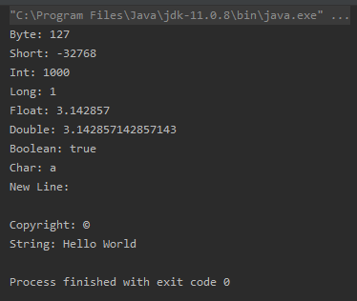
Data Types
Data Types:
Byte, Short, Int, Long
Float, Double
Boolean
Char
String

Slide 21
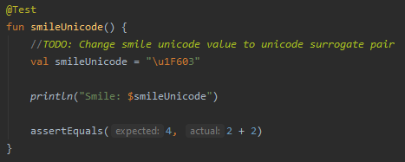
1.6.2 [Exercise] Declare Variables and Data Types
Repository
https://github.com/ferryyuwono/android-beginner/tree/main/1.06.02-Exercise-VariablesDataTypes
File
Write simpler code
ExampleUnitTest.kt
Explicit Conversion
Nullable data type
Unsigned data type
Surrogate pair unicode

Slide 22

1.6.3 [Solution] Declare Variables and Data Types
Repository
https://github.com/ferryyuwono/android-beginner/tree/main/1.06.03-Solution-VariablesDataTypes
File
Write simpler code
ExampleUnitTest.kt
Explicit Conversion
Nullable data type
Unsigned data type
Surrogate pair unicode

Slide 23
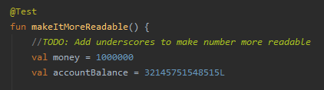
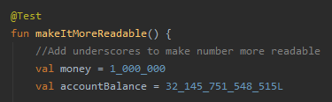
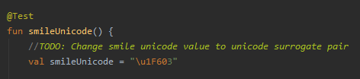



1.6.3 [Solution] Declare Variables and Data Types
Example on how to do the exercise and compare with solution

Slide 24
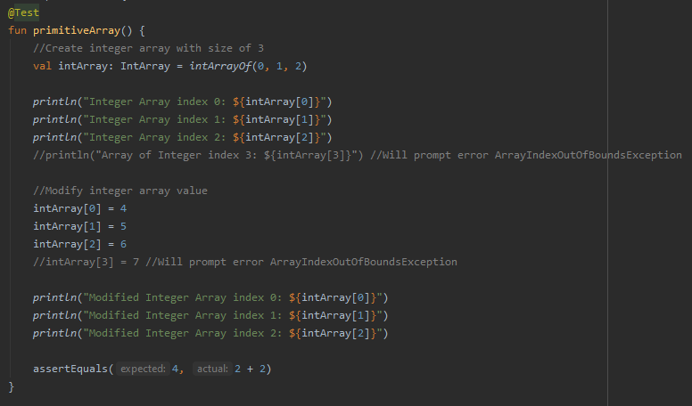
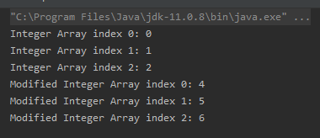
1.7.1 [Demo] Array and Collections
https://github.com/ferryyuwono/android-beginner/tree/main/1.07.01-Demo-ArrayCollections
File: ExampleUnitTest.kt
Array
Array:
Data Type: IntArray, LongArray, etc
Assignment: intArrayOf(values separate by comma)

Slide 25
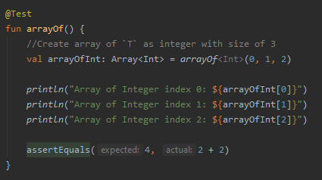
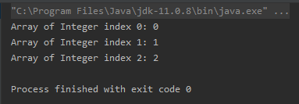
Array:
Data Type: Array<data type>
Assignment: arrayOf<data type>(values separate by comma)

Slide 26
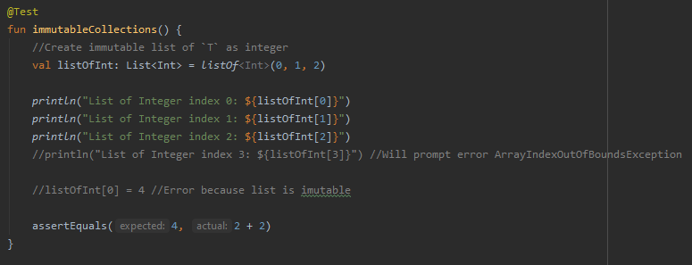
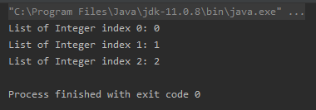
Collections
Collections:
Data Type: List<data type>
Assignment: listOf<data type>(values separate by comma)

Slide 27
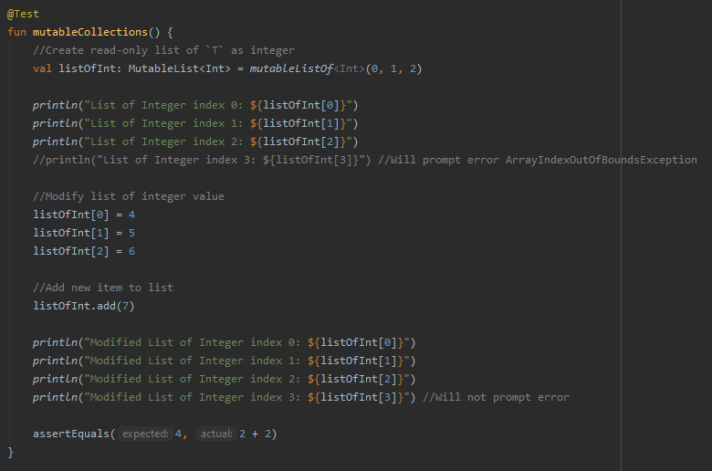
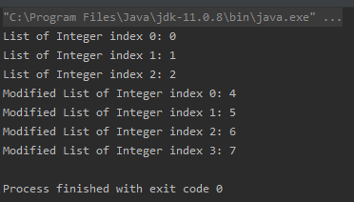
Collections:
Data Type: MutableList<data type>
Assignment: mutableListOf<data type>(values separate by comma)
Add new data: listOfInt.add(new value)

Slide 28
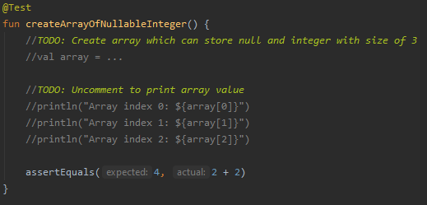
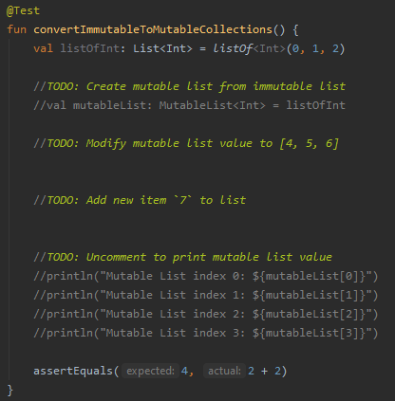
1.7.2 [Exercise] Array and Collections
Repository
https://github.com/ferryyuwono/android-beginner/tree/main/1.07.02-Exercise-ArrayCollections
File
ExampleUnitTest.kt
Array of nullable data type
Convert immutable to mutable collection

Slide 29
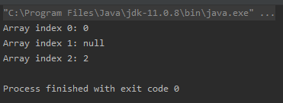
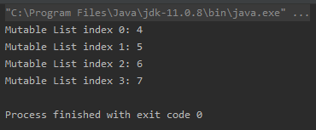
1.7.3 [Solution] Array and Collections
Repository
https://github.com/ferryyuwono/android-beginner/tree/main/1.07.03-Solution-ArrayCollections
File
ExampleUnitTest.kt
Array of nullable data type
Convert immutable to mutable collection

Slide 30
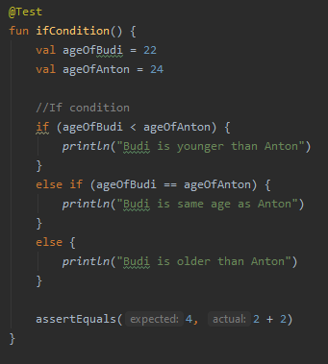

1.8.1 [Demo] Conditions
https://github.com/ferryyuwono/android-beginner/tree/main/1.08.01-Demo-Conditions
File: ExampleUnitTest.kt
if condition
Format:
if (condition 1) {
run this code if condition 1 is true
}
else if (condition 2) { //This else if is optional
run this code if condition 2 is true
}
else { //This else is optional
run this code if no condition is true
}

Slide 31
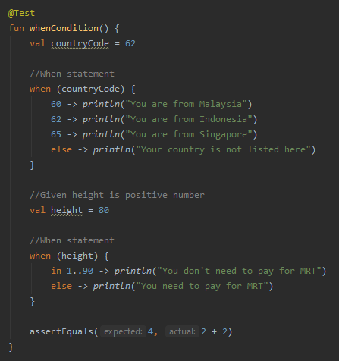
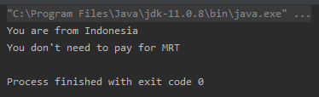
when condition
Format:
when (variable name) {
value 1 -> {
run this code when equals with value 1
}
value 2 -> {
run this code when equals with value 2
}
else -> {
run this code when no match value found
}
}

Slide 32
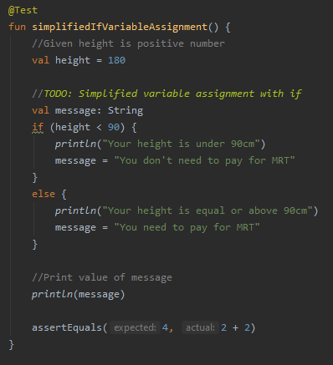
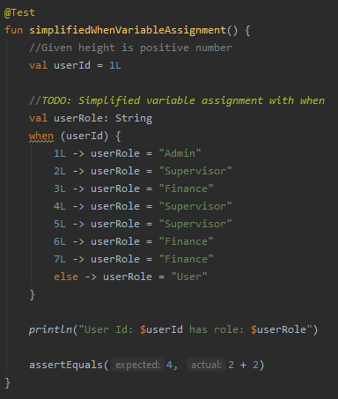
1.8.2 [Exercise] Conditions
Repository
https://github.com/ferryyuwono/android-beginner/tree/main/1.08.02-Exercise-Conditions
File
ExampleUnitTest.kt
Variable assignment with condition
Write simpler when condition

Slide 33
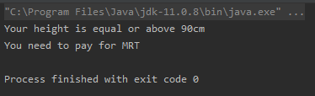

1.8.3 [Solution] Conditions
Repository
https://github.com/ferryyuwono/android-beginner/tree/main/1.08.03-Solution-Conditions
File
ExampleUnitTest.kt
Variable assignment with condition
Write simpler when condition

Slide 34
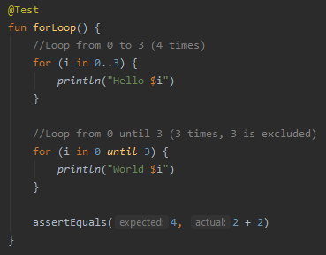
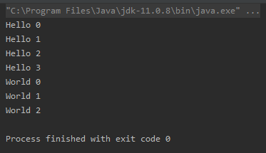
1.9.1 [Demo] Loops
https://github.com/ferryyuwono/android-beginner/tree/main/1.09.01-Demo-Loops
File: ExampleUnitTest.kt
For loops
Format:
for (loop variable in loop range) {
run this code until loop is done
}

Slide 35
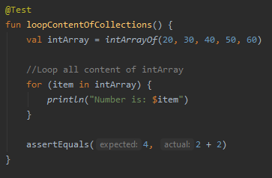

Format:
for (loop variable in collection) {
run this code until each value of collection is looped
}

Slide 36




While Loops
Do While Loops
Format:
while (while condition) {
run this code while condition is true
}
Format:
do {
run this code at least once
then check while condition
} while (while condition)

Slide 37


1.9.2 [Exercise] Loops
Repository
https://github.com/ferryyuwono/android-beginner/tree/main/1.09.02-Exercise-Loops
File
ExampleUnitTest.kt
For loop using downTo and step
Loop collection with index
Break loop
Skip data in loop

Slide 38


1.9.3 [Solution] Loops
Repository
https://github.com/ferryyuwono/android-beginner/tree/main/1.09.03-Solution-Loops
File
ExampleUnitTest.kt
For loop using downTo and step
Loop collection with index
Break loop
Skip data in loop

Slide 39


1.10.1 [Demo] Functions
https://github.com/ferryyuwono/android-beginner/tree/main/1.10.01-Demo-Functions
File: ExampleUnitTest.kt
Declare Function
Format:
fun function name(parameter) {
code inside function
}
function name: lower camelCase
parameter: separated by comma (optional)
Notes:
Reference
https://en.wikipedia.org/wiki/Camel_case

Slide 40


Function with return value
Format:
fun function name(parameter): data type {
code inside function
return data type
}
function name: lower camelCase
parameter: separated by comma (optional)

Slide 41


Function with default argument
Format:
fun function name(parameter = default value) {
code inside function
}

Slide 42


1.10.2 [Exercise] Functions
Repository
https://github.com/ferryyuwono/android-beginner/tree/main/1.10.02-Exercise-Functions
File
ExampleUnitTest.kt
Write single expression function
Using named argument in parameter
Extension function

Slide 43

1.10.3 [Solution] Functions
Repository
https://github.com/ferryyuwono/android-beginner/tree/main/1.10.03-Solution-Functions
File
ExampleUnitTest.kt
Write single expression function
Using named argument in parameter
Extension function

Slide 44


1.11.1 [Demo] Class and Data Class
https://github.com/ferryyuwono/android-beginner/tree/main/1.11.01-Demo-ClassDataClass
File: ExampleUnitTest.kt
Create new Kotlin Class
Notes:
Reference:
https://techterms.com/definition/pascalcase#:~:text=PascalCase%20is%20a%20naming%20convention,in%20PascalCase%20is%20always%20capitalized.

Slide 45



Class File
Person.kt
Format:
class class name(parameter) {
init { }
}
class name: PascalCase (start with capital letter)
parameter: separated by comma (optional)
init { }: constructor function which will be called when object of the class is created (optional)

Slide 46


Create Data Class
Data Class File
PersonData.kt
Format:
data class class name(parameter) {
init { }
}
class name: PascalCase (start with capital letter)
parameter: at least 1 parameter (mandatory)
init { }: constructor function which will be called when object of the data class is created (optional)

Slide 47





Slide 48

1.11.2 [Exercise] Class And Data Class
Repository
https://github.com/ferryyuwono/android-beginner/tree/main/1.11.02-Exercise-ClassDataClass
File
ExampleUnitTest.kt
Create instance of class using named argument
Companion object

Slide 49

1.11.3 [Solution] Class And Data Class
Repository
https://github.com/ferryyuwono/android-beginner/tree/main/1.11.03-Solution-ClassDataClass
File
ExampleUnitTest.kt
Create instance of class using named argument
Companion object

Slide 50
End of Module 1:
Good Job! See you in the next module

